Slide 1
IE 413 Project: A Bowling Alley
Steven Linshiu
Prateek Rungta

Slide 2
Overview
Introduction
Model Description
Experimental Procedure
Results
Analysis
Conclusion

Slide 3
Problem Statement
Discrete -event simulation of a bowling alley
OPEN: 12:00 PM
STOP adding to waiting list: 11:00 PM
CLOSE : all bowlers finish service
Arrivals in group
Assigned an available lane
Added to waiting list if all busy

Slide 4
Uncertainty
Balking = leave due to unwillingness to wait
Arrival time exponentially distributed (mean = 4 min)
Group size
Bowling time normally distributed

Slide 5
Objectives
Expand lanes decision
Maximum cost for extra pair of lanes
Sensitivity to model parameters

Slide 6
Entities & Attributes
Bowling center (permanent)
Number of lanes available
Group of customers (transient)
Group size
Bowling time

Slide 7
Event Graph
S → available lanes
Q → groups in line
OPEN → status of alley
60
LANES
(6)
60x24
(Q>0)
t_{a}
∫
∫
(DAY==1)
60
NEW DAY
(1)
OPEN
(1)
ARRIVE
(4)
(S>0)
START
(2)
t_{K}
FINISH
(3)
60x12
∫
(Q==0)
(S==16)
(OPEN==0)
60x11
∫
RUN
(1)
STOP
(5)
END
(6)
(WDAY==7)
CLOSE
(6)
∫
7*24*60+11*60-CLK

Slide 8
NEW DAY
State Changes:
DAY = DAY + 1
60
LANES
(6)
60x24
(Q>0)
t_{a}
∫
∫
(DAY==1)
60
NEW DAY
(1)
OPEN
(1)
ARRIVE
(4)
(S>0)
START
(2)
t_{K}
FINISH
(3)
60x12
∫
(Q==0)
(S==16)
(OPEN==0)
60x11
∫
RUN
(1)
STOP
(5)
END
(6)
(WDAY==7)
CLOSE
(6)
∫
7*24*60+12*60-CLK

Slide 9
OPEN
State Changes:
OPEN = 1
WDAY = WDAY + 1
60
LANES
(6)
60x24
(Q>0)
t_{a}
∫
∫
(DAY==1)
60
NEW DAY
(1)
OPEN
(1)
ARRIVE
(4)
(S>0)
START
(2)
t_{K}
FINISH
(3)
60x12
∫
(Q==0)
(S==16)
(OPEN==0)
60x11
∫
RUN
(1)
STOP
(5)
END
(6)
(WDAY==7)
CLOSE
(6)
∫
7*24*60+12*60-CLK

Slide 10
LANES
State Changes:
HOUR = CLK/60 – 24*(DAY-1)
L[HOUR]=L[HOUR]+(16-S)
60
LANES
(6)
60x24
(Q>0)
t_{a}
∫
∫
(DAY==1)
60
NEW DAY
(1)
OPEN
(1)
ARRIVE
(4)
(S>0)
START
(2)
t_{K}
FINISH
(3)
60x12
∫
(Q==0)
(S==16)
(OPEN==0)
60x11
∫
RUN
(1)
STOP
(5)
END
(6)
(WDAY==7)
CLOSE
(6)
∫
7*24*60+12*60-CLK

Slide 11
STOP
State Changes:
OPEN = 0
ARRIVE [15000]=CLK
60
LANES
(6)
60x24
(Q>0)
t_{a}
∫
∫
(DAY==1)
60
NEW DAY
(1)
OPEN
(1)
ARRIVE
(4)
(S>0)
START
(2)
t_{K}
FINISH
(3)
60x12
∫
(Q==0)
(S==16)
(OPEN==0)
60x11
∫
RUN
(1)
STOP
(5)
END
(6)
(WDAY==7)
CLOSE
(6)
∫
7*24*60+12*60-CLK

Slide 12
ARRIVE
State Changes:
Y= RND
X = I{S>0} + I{S==0}*I{Q<=5} +
I{S==0}*I{Q>=6)*I{Q<=15}*I{Y>=(Q/10-0.5)}
AI = AI + X, A=AI*X, B=B + (1-X),
Q=Q+X, ARRIVE[A]=CLK
60
LANES
(6)
60x24
(Q>0)
t_{a}
∫
∫
(DAY==1)
60
NEW DAY
(1)
OPEN
(1)
ARRIVE
(4)
(S>0)
START
(2)
t_{K}
FINISH
(3)
60x12
∫
(Q==0)
(S==16)
(OPEN==0)
60x11
∫
RUN
(1)
STOP
(5)
END
(6)
(WDAY==7)
CLOSE
(6)
∫
7*24*60+12*60-CLK

Slide 13
START
State Changes:
Y=RND , S=S-1, Q=Q-1, SI=SI+1
WAIT = WAIT+ (CLK-ARRIVE[SI])
K[SI] = 1*I{Y<0.3} + 2*I{Y>=0.3}*I{Y<0.5}
+3*I{Y>=0.5}*I{Y<0.6} + 4*I{Y>=0.6}
N = N + K[SI]
60
LANES
(6)
60x24
(Q>0)
t_{a}
∫
∫
(DAY==1)
60
NEW DAY
(1)
OPEN
(1)
ARRIVE
(4)
(S>0)
START
(2)
t_{K}
FINISH
(3)
60x12
∫
(Q==0)
(S==16)
(OPEN==0)
60x11
∫
RUN
(1)
STOP
(5)
END
(6)
(WDAY==7)
CLOSE
(6)
∫
7*24*60+12*60-CLK

Slide 14
FINISH
State Changes:
S = S+1
60
LANES
(6)
60x24
(Q>0)
t_{a}
∫
∫
(DAY==1)
60
NEW DAY
(1)
OPEN
(1)
ARRIVE
(4)
(S>0)
START
(2)
t_{K}
FINISH
(3)
60x12
∫
(Q==0)
(S==16)
(OPEN==0)
60x11
∫
RUN
(1)
STOP
(5)
END
(6)
(WDAY==7)
CLOSE
(6)
∫
7*24*60+12*60-CLK

Slide 15
CLOSE
State Changes:
CTIME = CTIME + (CLK-ARRIVE[15000])
60
LANES
(6)
60x24
(Q>0)
t_{a}
∫
∫
(DAY==1)
60
NEW DAY
(1)
OPEN
(1)
ARRIVE
(4)
(S>0)
START
(2)
t_{K}
FINISH
(3)
60x12
∫
(Q==0)
(S==16)
(OPEN==0)
60x11
∫
RUN
(1)
STOP
(5)
END
(6)
(WDAY==7)
CLOSE
(6)
∫
7*24*60+12*60-CLK

Slide 16
END
State Changes:
TERMINATE SIMULATION
AFTER 1 ITERATION OF END
60
LANES
(6)
60x24
(Q>0)
t_{a}
∫
∫
(DAY==1)
60
NEW DAY
(1)
OPEN
(1)
ARRIVE
(4)
(S>0)
START
(2)
t_{K}
FINISH
(3)
60x12
∫
(Q==0)
(S==16)
(OPEN==0)
60x11
∫
RUN
(1)
STOP
(5)
END
(6)
(WDAY==7)
CLOSE
(6)
∫
7*24*60+12*60-CLK

Slide 17
Experimental Procedure
Same initial conditions
1 run (sample) = 7 days with unique seed
Replicate 30 runs independently seeded
Repeat for different lane capacities
Total of 180 simulations

Slide 18
Data collection
High speed option in SIGMA
Trace only event END to collect the necessary data
Import excel
Compute averages for 7 days
Compute mean for 30 replications
Compute confidence intervals

Slide 19
Sample data
 | LANE = 16
 | Mean | Stdev | Up 95% CI | Lo 95% CI
F | 0.14 | 0.03 | 0.16 | 0.13
AWAIT | 3351.60 | 413.61 | 3506.05 | 3197.16
AGWAIT | 3.36 | 0.43 | 3.52 | 3.20
AVEOT | 148.82 | 8.11 | 151.85 | 145.79
AVECT | 1.48 | 0.14 | 1.53 | 1.43
AL[12] | 0.86 | 0.00 | 0.86 | 0.86
AL[13] | 12.96 | 1.14 | 13.39 | 12.54
AL[14] | 15.34 | 0.63 | 15.58 | 15.11
AL[15] | 15.55 | 0.43 | 15.71 | 15.39
AL[16] | 15.74 | 0.40 | 15.89 | 15.59
AL[17] | 15.79 | 0.38 | 15.93 | 15.64
AL[18] | 15.87 | 0.32 | 15.98 | 15.75
AL[19] | 15.92 | 0.16 | 15.98 | 15.86
AL[20] | 15.93 | 0.16 | 15.99 | 15.87
AL[21] | 15.94 | 0.15 | 16.00 | 15.89
AL[22] | 15.87 | 0.24 | 15.96 | 15.78
AL[23] | 15.89 | 0.28 | 15.99 | 15.78
AL[0] | 10.25 | 0.91 | 10.59 | 9.91
AL[1] | 2.78 | 0.63 | 3.02 | 2.55
AL[2] | 0.13 | 0.11 | 0.17 | 0.09
AVER | 1862.98 | 19.22 | 1870.15 | 1855.80
AVEC | 243.48 | 53.37 | 263.40 | 223.55

Slide 20
Results
 | Means
LANES | 16 | 18 | 20 | 22 | 24 | 26
F | 0.14 | 0.08 | 0.04 | 0.01 | 0.00 | 0.00
AWAIT | 3351 | 2350 | 1330 | 689 | 276 | 114
AGWAIT | 3.36 | 2.16 | 1.18 | 0.60 | 0.24 | 0.10
AVEOT | 148.82 | 137.86 | 126.81 | 123.58 | 122.18 | 118.80
AVECT | 1.48 | 1.30 | 1.11 | 1.06 | 1.04 | 0.98

Slide 21
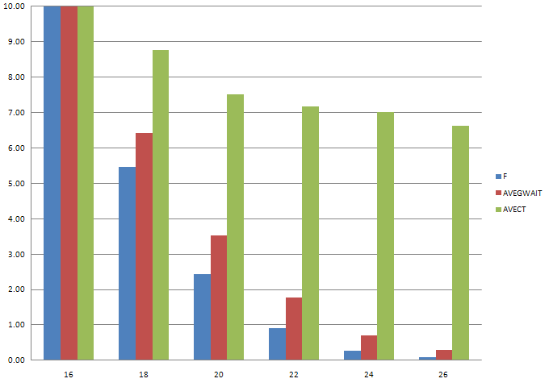
Scaled statistics vs # lanes

Slide 22
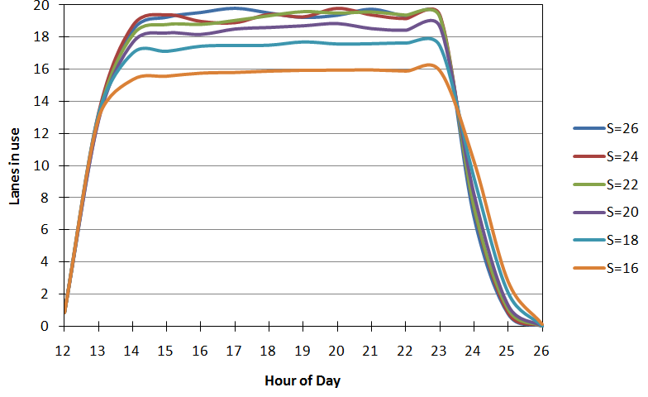
Distribution of lanes is use
12 13 14 15 16 17 18 19 20 21 22 23 0 1 2

Slide 23
5-year Profit
LANES | 16 | 18 | 20 | 22 | 24 | 26
AVER/day | $1,862 | $2,010 | $2,080 | $2,134 | $2,145 | $2,146
AVEC/day | $243.48 | $133.10 | $59.19 | $22.00 | $6.67 | $2.14
5-Year Revenue | $3,399,932 | $3,668,858 | $3,797,564 | $3,894,724 | $3,916,059 | $3,918,188
5-Year Cost | $444,344 | $242,899 | $108,023 | $40,150 | $12,167 | $3,911
5-Year Profit | $2,955,588 | $3,425,960 | $3,689,542 | $3,854,574 | $3,903,892 | $3,914,277

Slide 24
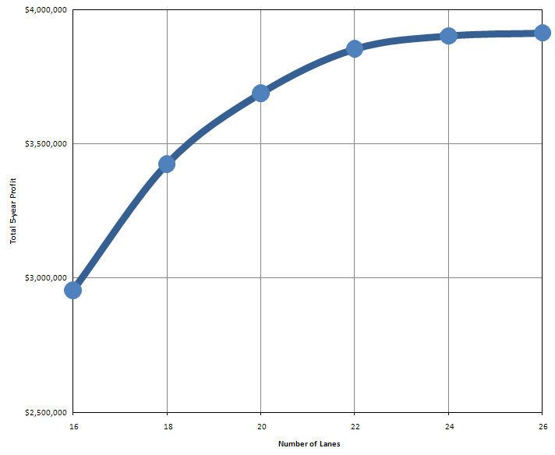
5-year Profit vs # lanes

Slide 25
Upgrade lanes from 16
Maximum to invest = Increase in 5-year profit
Recover cost in 5 years
Maximum cost per pair of lanes = Increase/#pairs
Added Lanes | 2 | 4 | 6 | 8 | 10
Increase in 5-year profit | $470,372 | $733,954 | $898,986 | $948,305 | $958,690
Cost per pair of Lane | $470,372 | $366,977 | $299,662 | $237,076 | $191,738

Slide 26
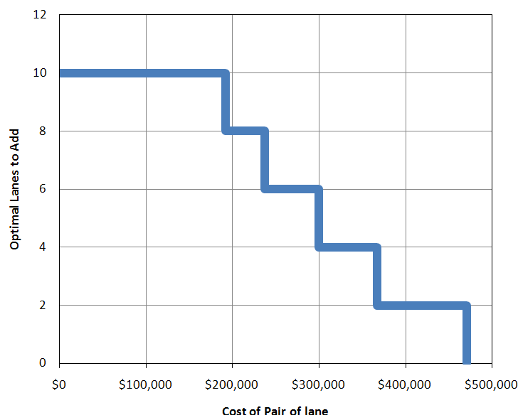
Optimal Upgrade from 16 lanes
$250,00

Slide 27
Sensitivity - Procedure
One seed
Parameters:
Mean inter-arrival time
Mean bowling time
Standard deviation bowling time
Revenue per bowler
Two changes each
Changes one at a time

Slide 28
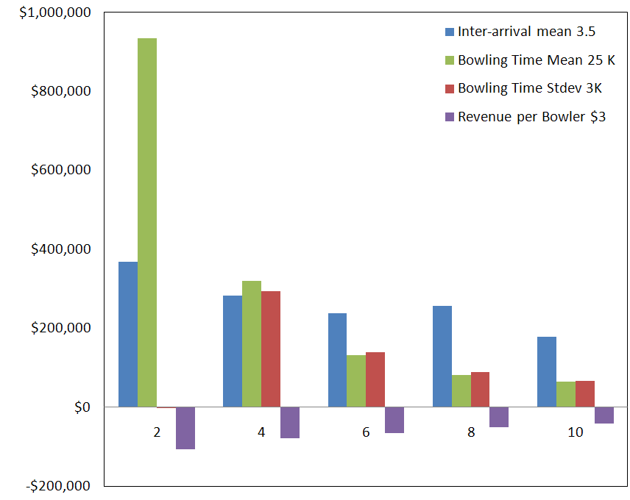
Changes in cost per pair of lane
Decrease in Parameters
Change in cost per lane wtr to original
Added Lanes

Slide 29
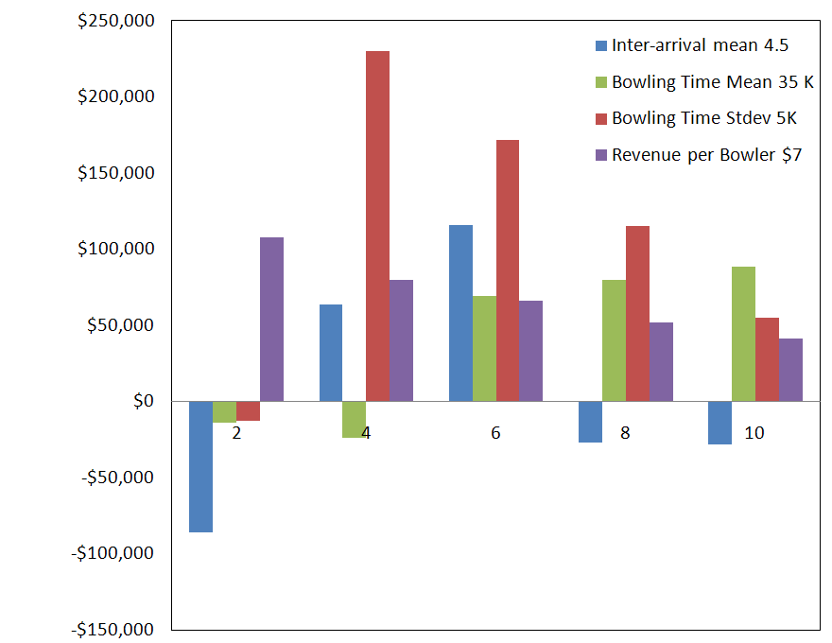
Changes in cost per pair of lane
Increase in Parameters
Change in cost per lane wtr to original
Added Lanes

Slide 30
Conclusions
Decision = expand available lanes
Optimal decision = depends on actual cost of pair of lanes
Need to explore more sensitivity

Slide 31
Questions? Comments?

